Slide 1

Zeno Berkhan, Nico Diefenbacher, (Paul Mayer)

Slide 2
Content
Introduction and idea
Technologiestack
Project Management
RUP Workflow
Mockup
Usecases
Classdiagrams and Database Model
Django
Demo
Test

Slide 3



Introduction and Idea

Slide 5
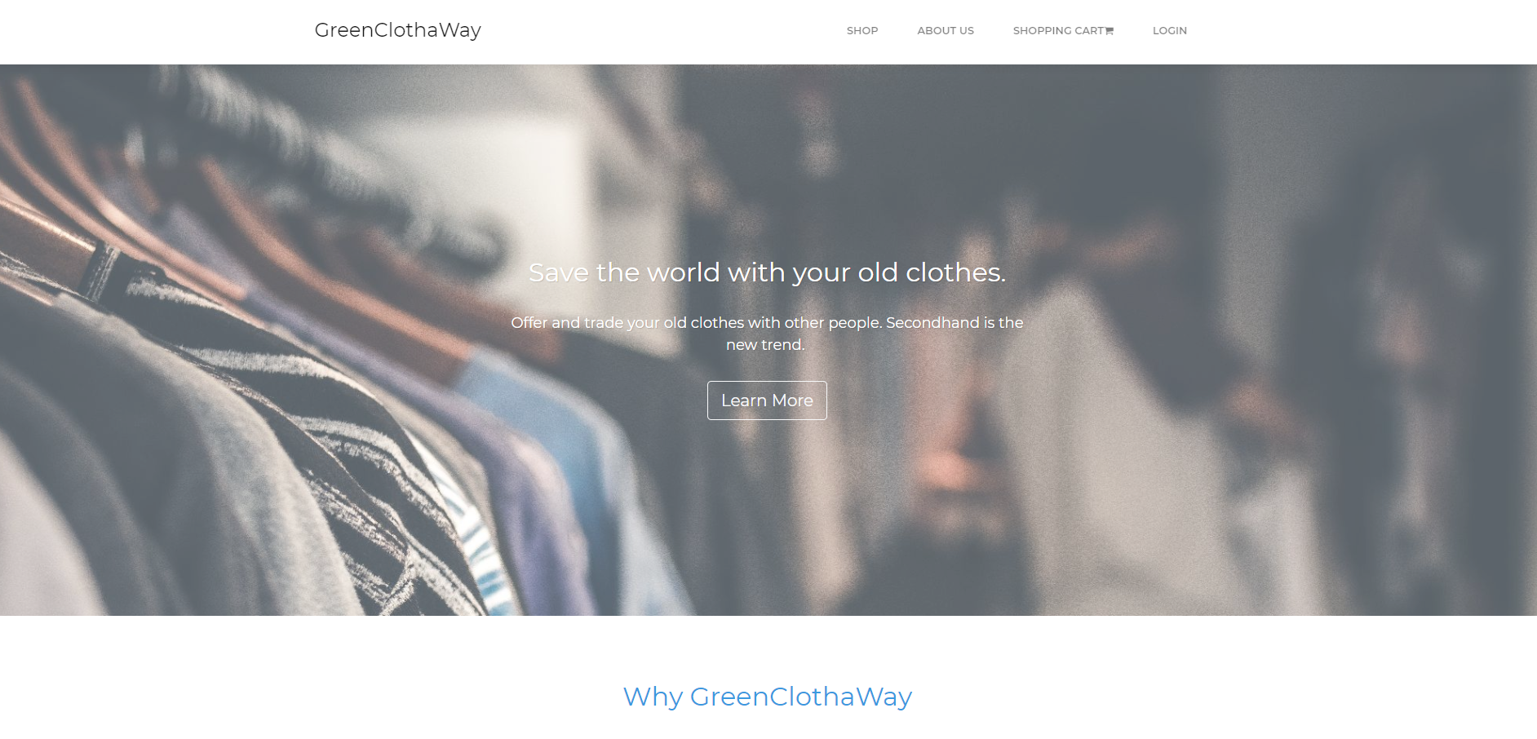

Slide 6










Slide 7
Project Management
Dailys
Weeklys/Homework
Stay on the right path

Slide 8
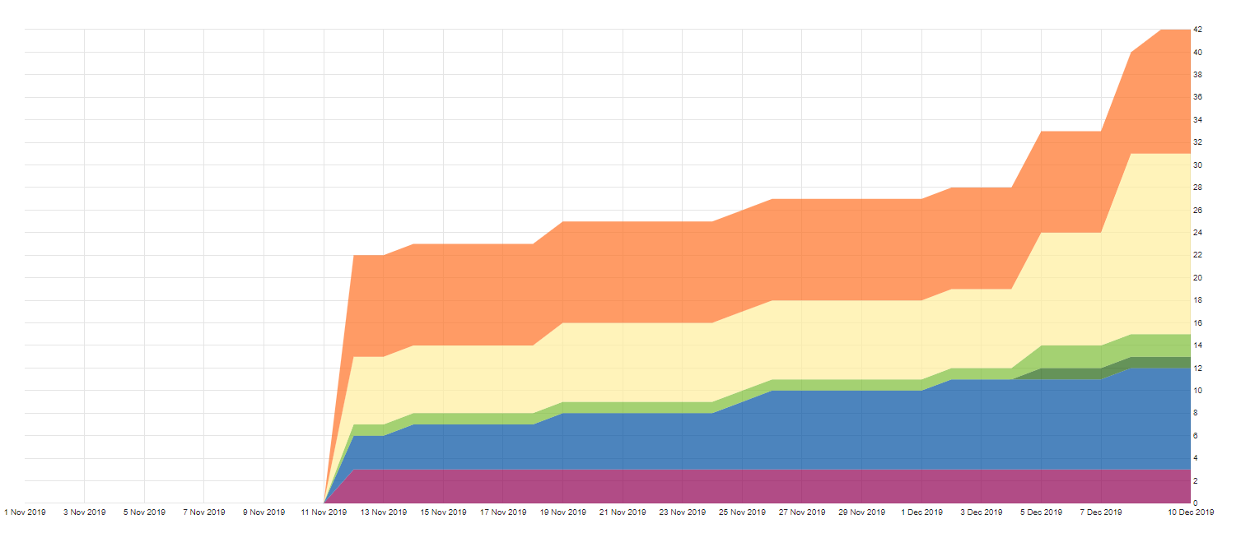
RUP Workflow (Cumulative Flow)

Slide 9
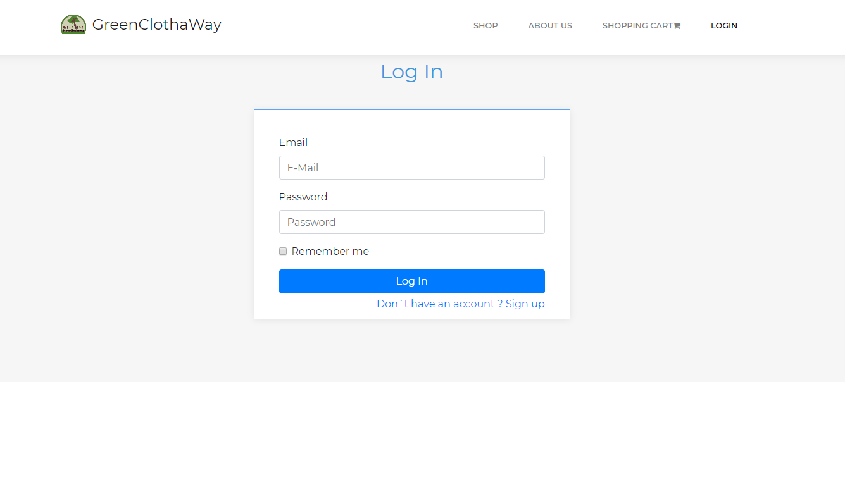
Mockup

Slide 10
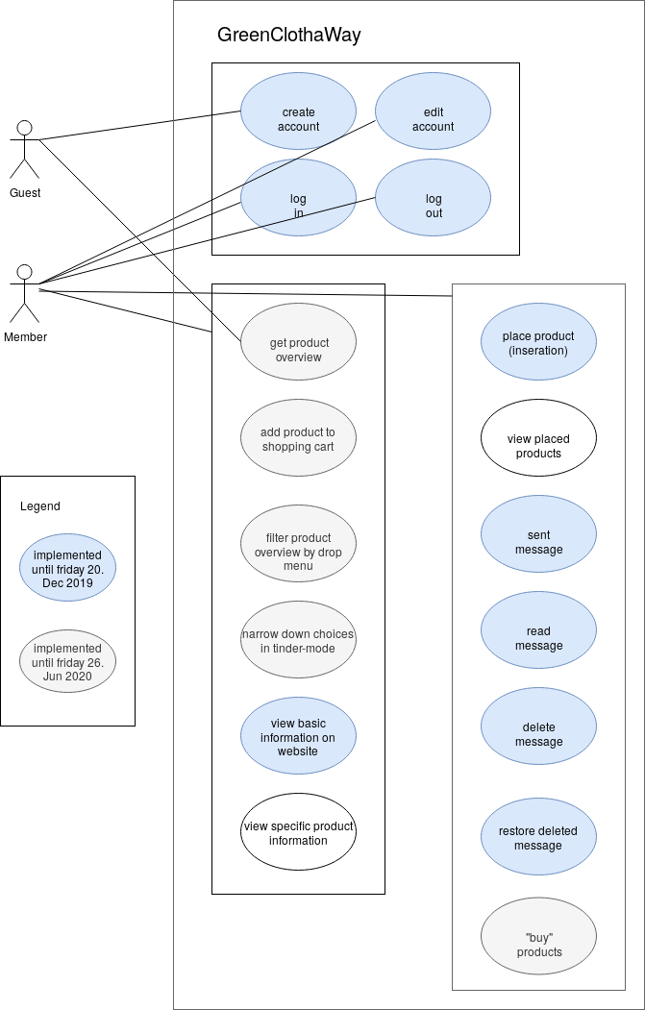
Usecases

Slide 11
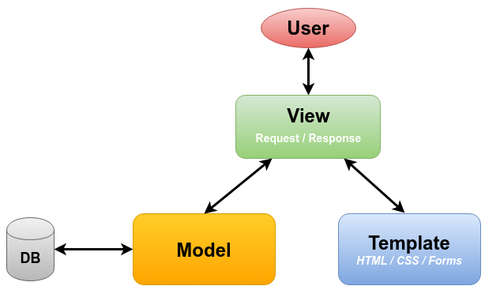
Django

Slide 12
Classdiagrams

Slide 13
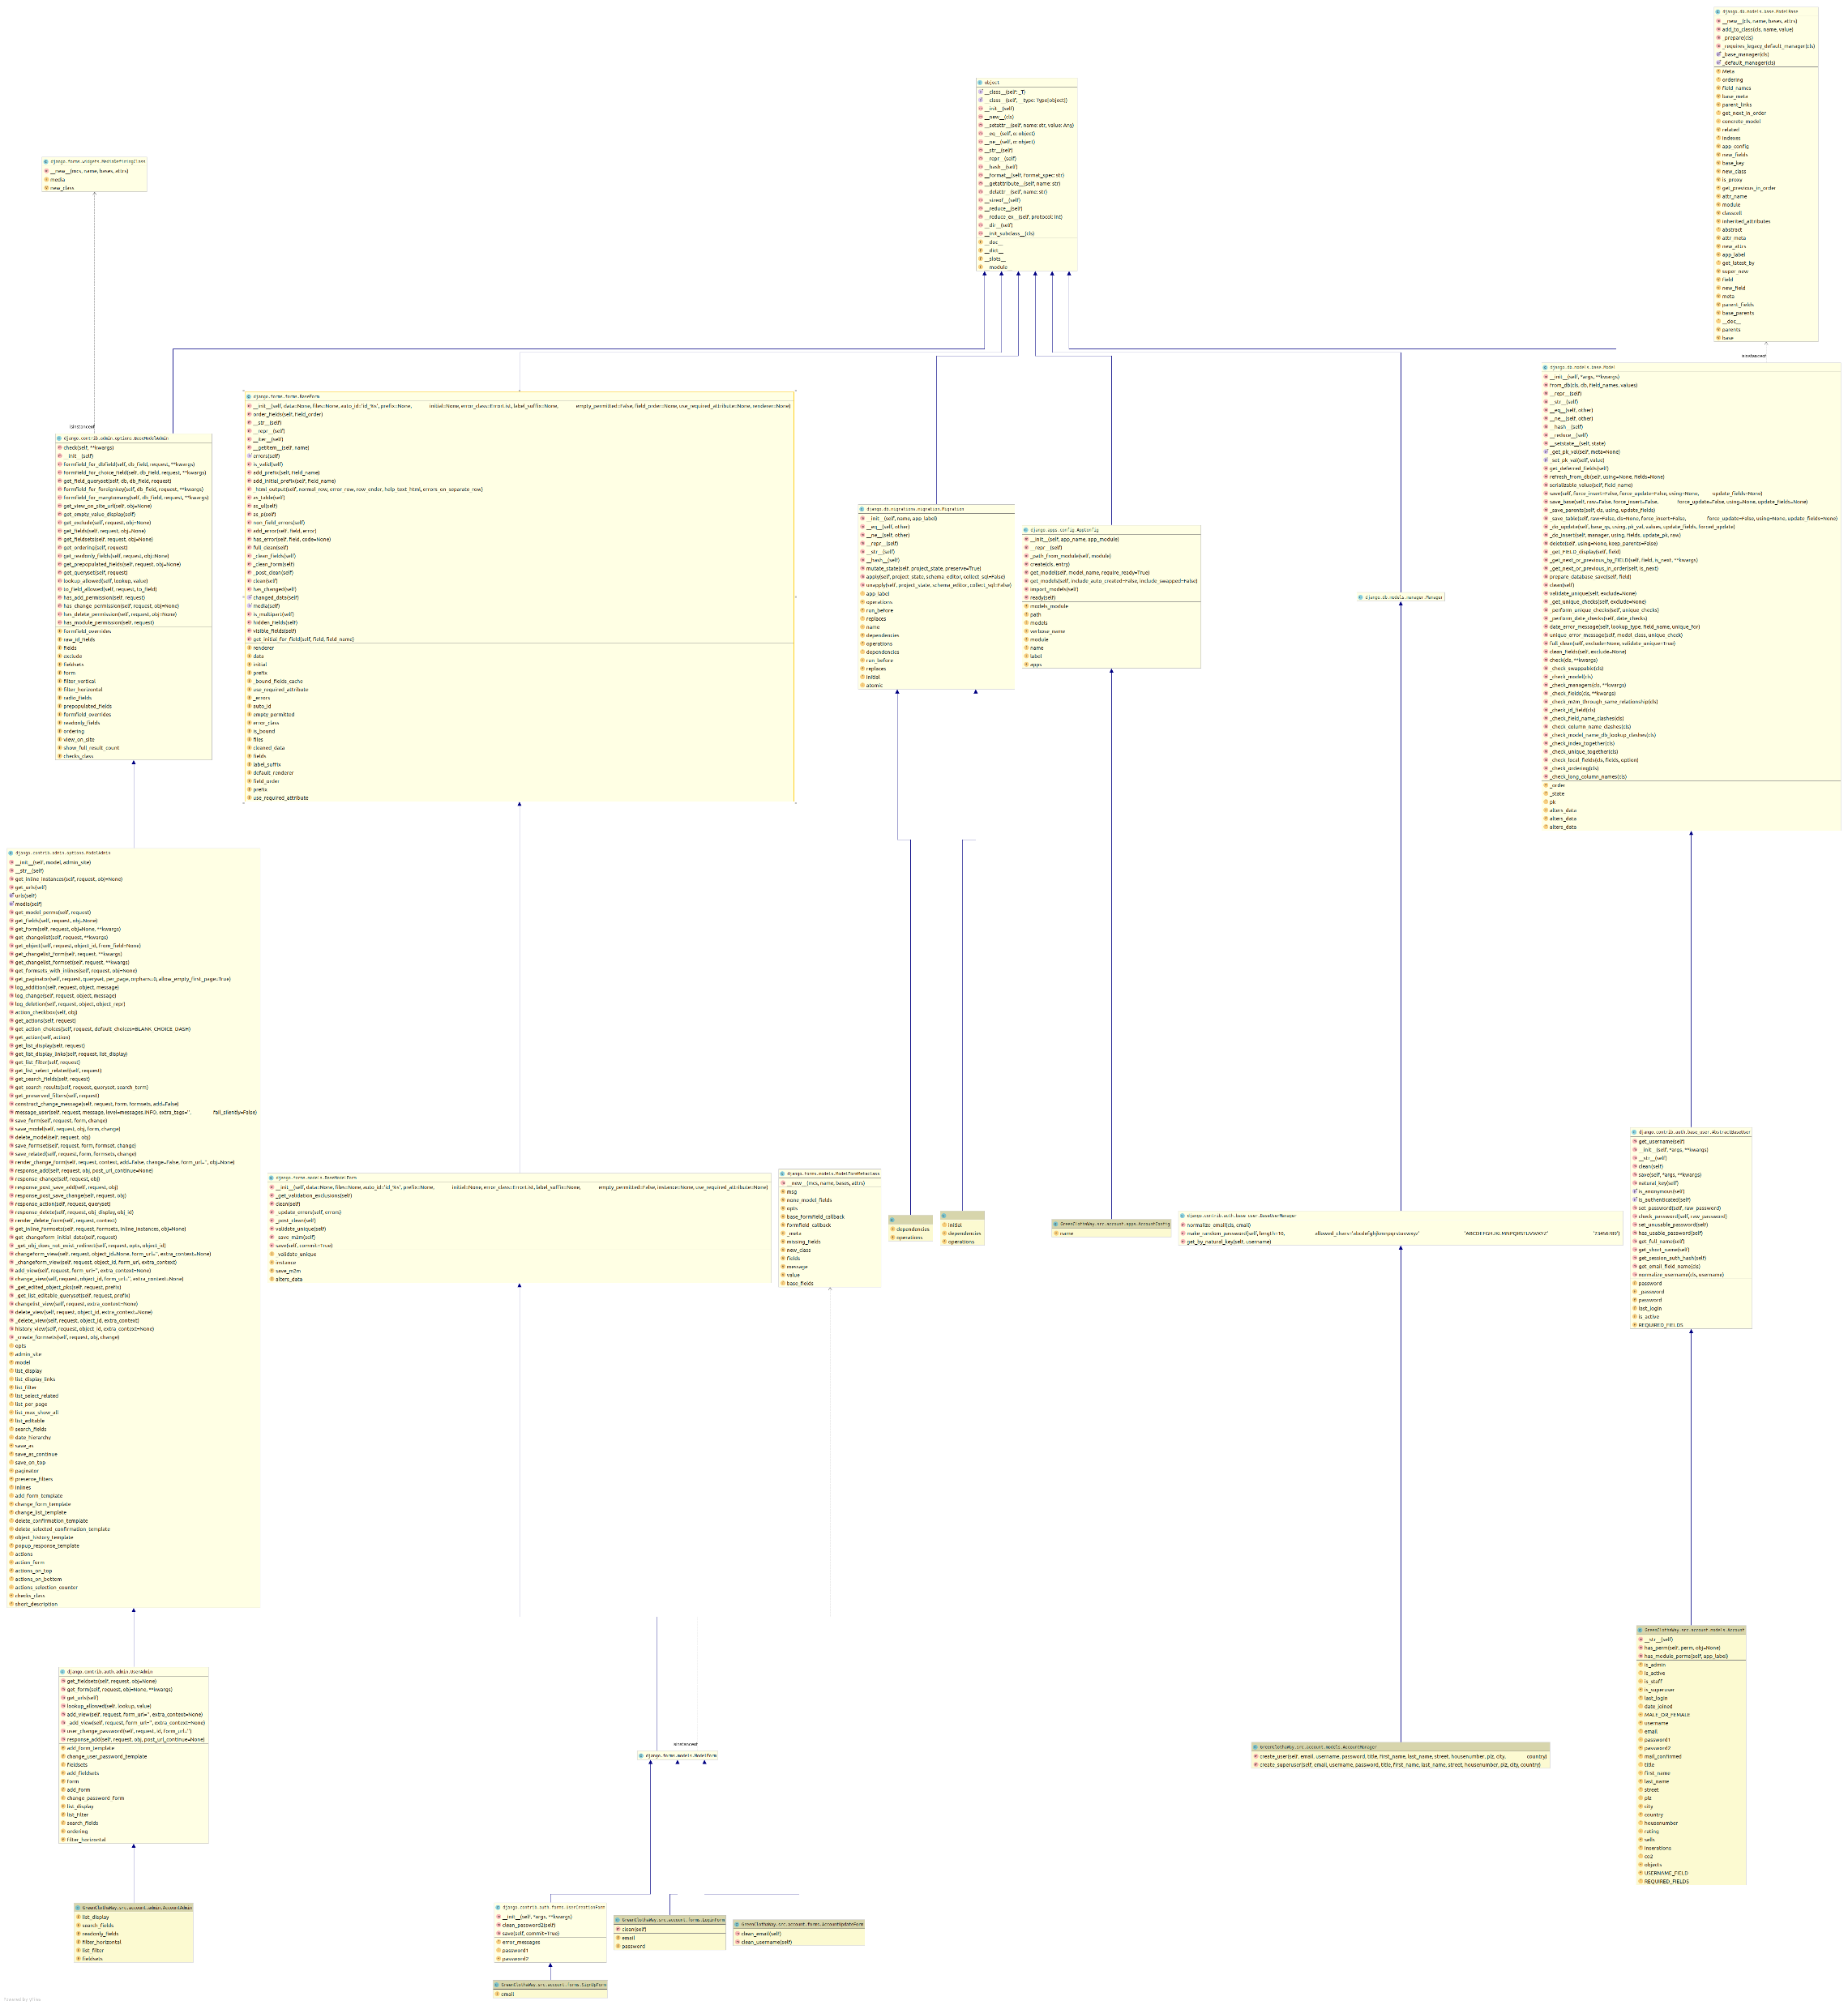
Account

Slide 14
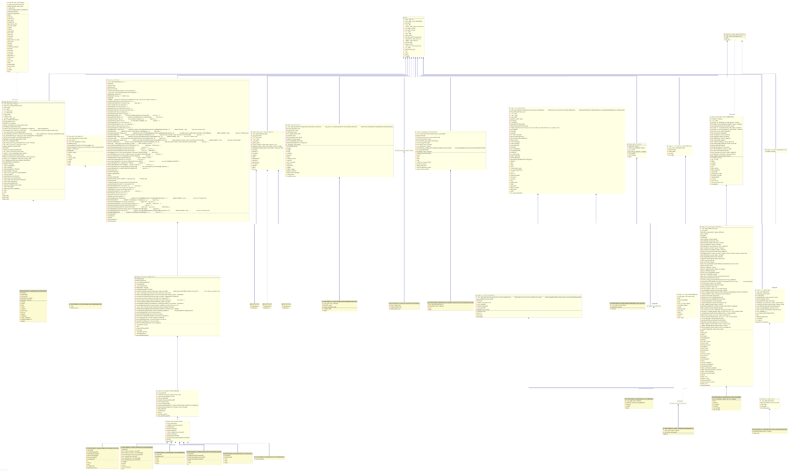
Messages

Slide 15
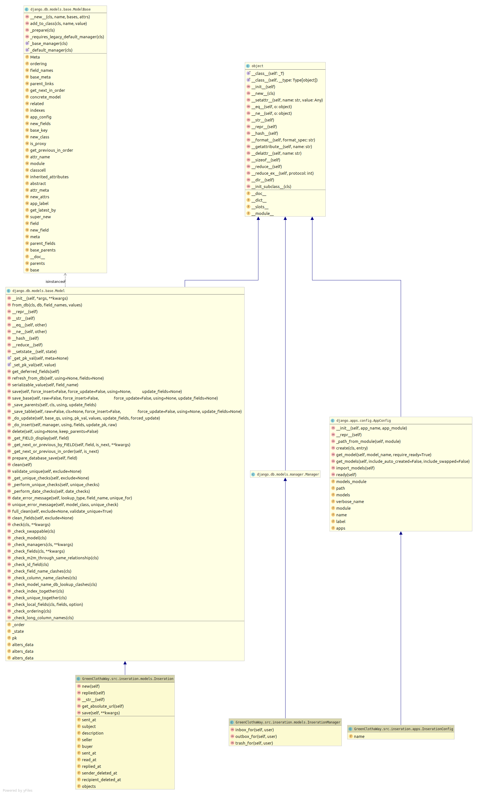
Inseration

Slide 16
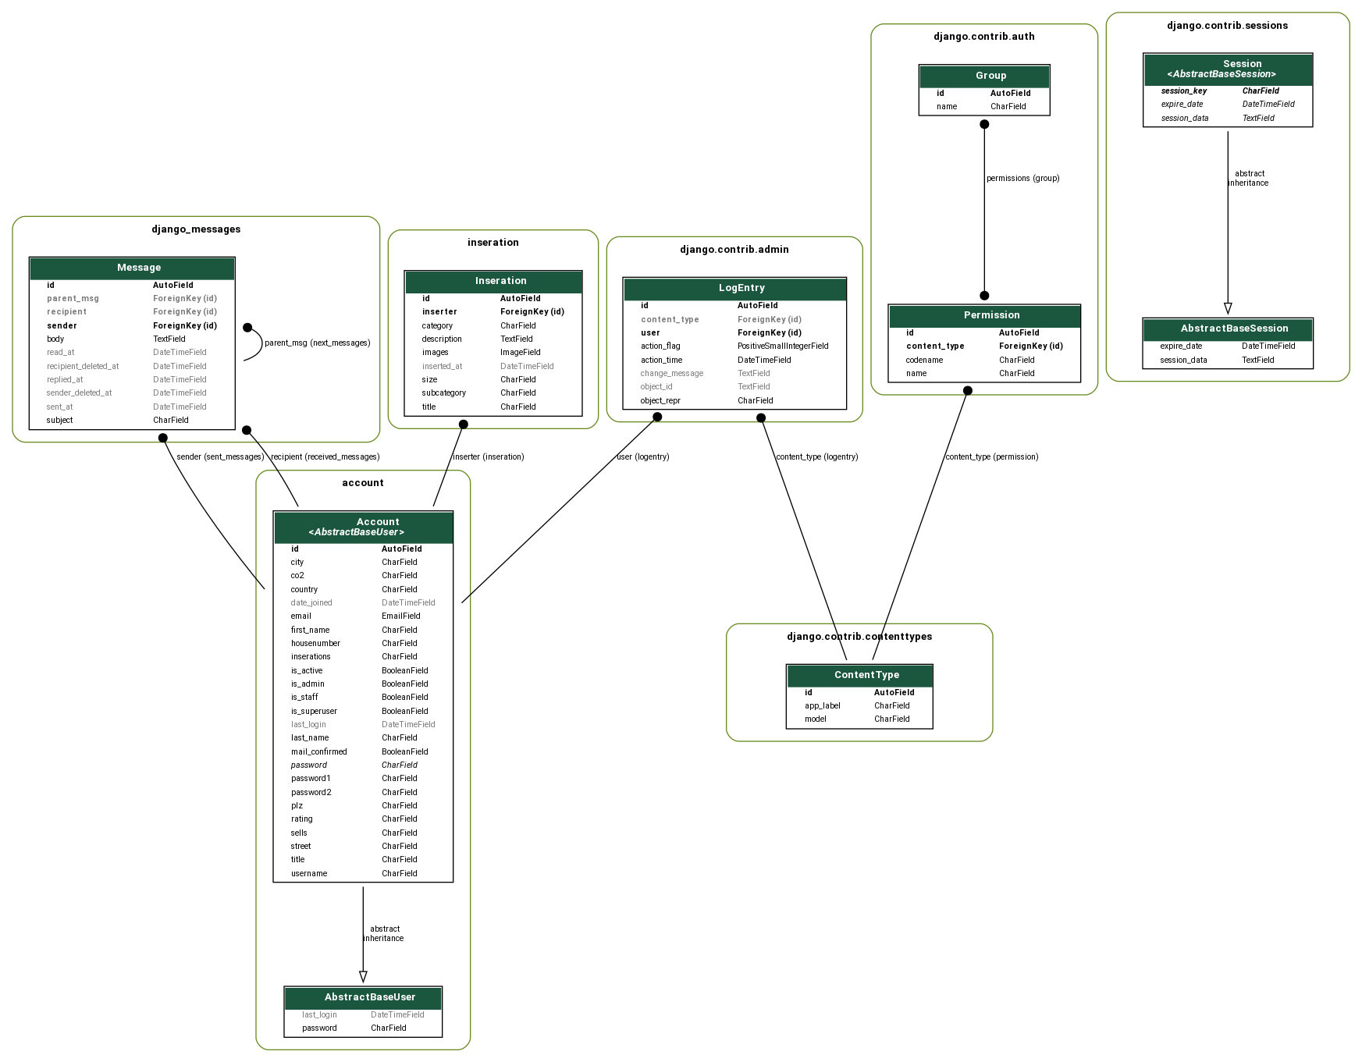
Database Model

Slide 17
Demo

Slide 18
Test

